Slide 1

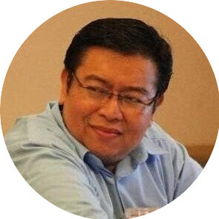
Seri Pemebalajaran Monetisasi
Monetisasi Mobile Apps Multimedia Interaktif Smart Apps Creator
Ir. M. Haitan Rachman MT., KMPC
Founder and Senior Consultant
SAC Principal Indonesia

